Slide 1

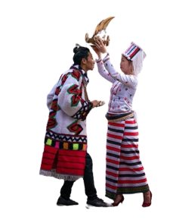
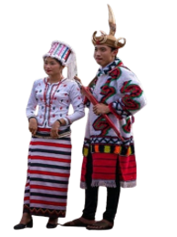
Hybrid Approach to Rawang Language Word Segmentation
Using Part-of-Speech Tagging
Supervised by
Third Seminar
Presented by
Dr. Naw Thiri Wai Khin
29.8.2024
Mg Mabu Phong(6IST-21)

Slide 2
Outlines
Abstract
Objectives
Theory Background
Scope of Thesis
System Design and System Flow
Benefits
Limitations
Further Extension
Conclusion
1

Slide 3
Abstract
Natural Language Processing, or NLP, is a field that teaches computers to understand human language.
NLP aims to achieve powerful tasks such as machine translation, text summarization, and information retrieval and so on.
To enhance accuracy in these areas, foundational NLP processes are essential.
The proposed system targets Rawang word segmentation and Part-Of-Speech (POS) tagging, representing foundational processes in NLP.
Word segmentation is achieved using the Maximum Matching Algorithm using Rawang words corpus.
POS tagging is implemented through Conditional Random Fields model using metrics, refining as needed.
2

Slide 4
Objective
To preserve Rawang language representing our preserved culture
To develop a diverse Rawang language corpus
To perform word segmentation using Maximum matching algorithm
To design a tailored CRF model for precise Rawang POS tagging
3

Slide 5
Scope of Thesis
1
Rawang word corpus and POS tag corpus creation
Word Segmentation with Maximum Matching Algorithm
2
3
Training POS tag corpus with Conditional Random Field
Creating Graphical User Interface for predicting input sentence
4
4

Slide 6
Corpus Creation (Cont’d)
1
Unduplicated Word Corpus
2
Labeled-Sentences Corpus
shv̀msòpuq
tiberia
shvlo
lvwà
ma
ínìgø
zv́ng
má
dakngòe
Dvtuq
vrá/CONJ tiqpè/N nø/AUX shvt/V bǿà/CV
íwe/CONJ nàmaq/PRO í/C kadø/IR dèdvm/V nø̀ng/P e/CV
yesu/N í/C àngmaq/PRO sv̀ng/C vtán/V òe/CV
àngmaq/PRO sv̀ng/C dvban/V ò/P e/CV
nà/PRO mvtu/N è/PF lvng/V shì/SF nø̀/CONJ è/PF lo/V
nvpè/N nvmè/N sv̀ng/C nàpǿ/V ò/P
3000 words
4000 sentences
5

Slide 7
Theory Background
Word segmentation or tokenization is a process of dividing a continuous text into separate words or tokens.
Bidirectional Maximum Matching algorithm is utilized for efficient word segmentation.
Maximum matching algorithm is popular for limited corpus or dataset.
Part-of-Speech Tagging is assigning grammar labels to each segmented words.
Part-of-Speech Tagging is performed using Conditional Random Fields, a statistical machine learning algorithm.
6

Slide 8
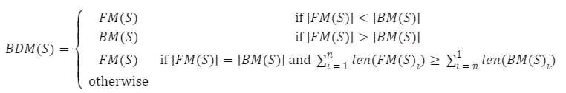
Bidirectional Maximum Matching Algorithm(Cont’d)
Word segmentation complexity depends on the nature of each language.
In the Rawang language, there is an explicit space between individual words or phrases, simplifying the process of word segmentation.
Notably, the maximum matching algorithm includes forward, backward, and bidirectional matching.
7

Slide 9
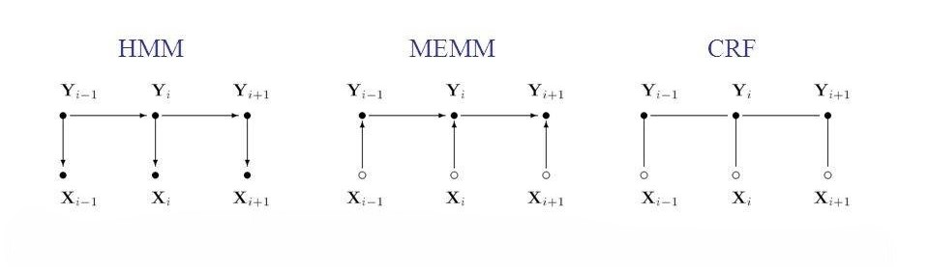
Conditional Random Fields (Cont’d)
Let X be the input features and Y be the output sequence. The joint probability distribution of a CRF is given by:
8

Slide 10
System Design
start
Input Rawang text
Sentence Segmentation
Word Segmentation
Maximum Matching Algorithm
Word Corpus
POS Tagging
CRF Model
Labeled Corpus
Display words with tags
End
9

Slide 11
Benefits
This system helps preserve the Rawang language by creating a structured digital corpus, ensuring the language is documented and accessible for future generations.
The POS tagging system serves as an educational tool for teaching and learning the Rawang language, providing resources for schools and language enthusiasts within the community.
This system lays the groundwork for more advanced NLP applications, such as machine translation, speech recognition, and sentiment analysis, tailored to the Rawang language.
This system is developed under an open-source license, allowing it to be freely used for any research purposes.
10

Slide 12
Limitations
The proposed system is organized by a total of nearly 3,000 words for word segmentation and nearly 4,000 labeled-sentences for POS tagging.
Segmentation error can occur when the words are not listed in Corpus and can effect the accuracy of POS tagging
The bidirectional matching algorithm used for word segmentation has inherent weaknesses.
CRFs require a large amount of labeled training data to learn accurate weights, which can be a limitation for languages or domains with limited annotated data.
11

Slide 13
Future Extension
Integration of advanced machine learning techniques
Incorporation of complex linguistic features
Expansion of the dataset
Establishment of connections with other language processing platforms
Sharing and explaining the system to the Rawang public
12

Slide 14
Basic NLP Analysis Pipeline
1
Word Segmentation
2
Part-of-Speech Tagging (POS)
3
Named Entity Recognition (NER)
4
Lexical (or) Morphology
5
Stemming (or) Lemmatization
6
Sentiment
7
Other
13

Slide 15
Rawang POS Tag Sets
Noun (NN)
Pronoun (PRON)
Verb (V)
Preposition (PREP)
Adjective (ADJ)
Adverb (ADP)
Conjunction (CONJ)
Interjection (INT)
Auxiliary (AUX)
Particle (P)
Interrogative (IR)
Number (NUM)
Number Text (NT)
Chronological Verb (CV)
Case(C)
Demonstrator (DM)
Quantity (Q)
14

Slide 16
Conclusion
Tokenization is a crucial step before POS tagging because POS tagging relies on the individual tokens to assign the correct grammatical category.
POS tagging is commonly performed after word segmentation or tokenization.
Precise foundational analysis in NLP enhances advanced tasks such as machine translation, summarization, information extraction, and more.
15

Slide 17
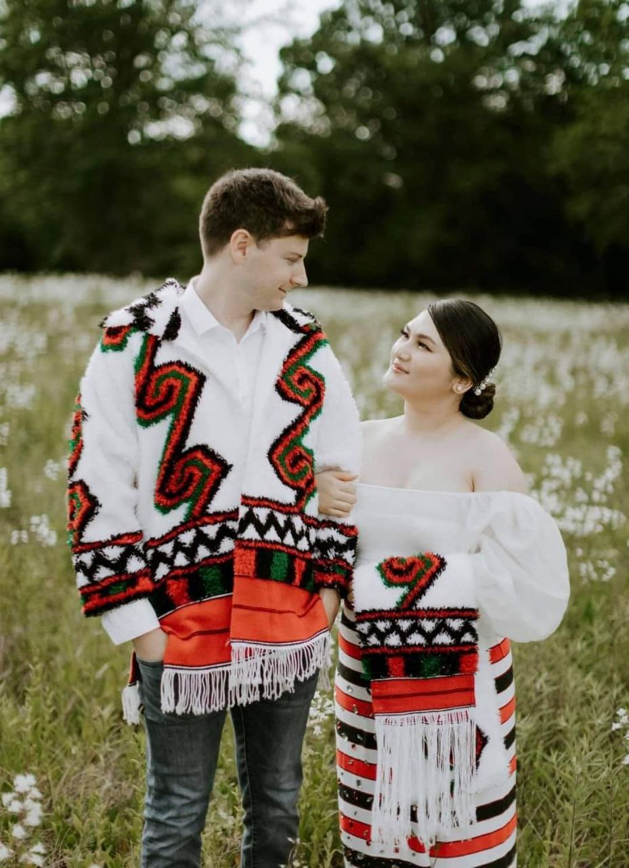
Thank you

